Slide 1
TN3125
Information and Computation
Lecture 3
1- Introduction
Notes:
Good morning and welcome to this course information and computation.
This course is part of the minor in quantum information. You may wonder why bother learning about information and computation in general when you want to learn about quantum information and quantum computation?
Well, it turns out the general picture mattes quite a bit, we are amazed by the power of quantum, but only because we compare it to the prequantum world. Our goal in this course is to learn all the necessary tools of classical computation and information such that you are able to appreciate the power of quantum information and quantum computation. But also, such that you can appreciate when quantum is of no use. It turns out, that this is in fact the most common situation. Quantum, helps inmensely with a small but selected set of problems.
A second reason to learn about this topics is because it is mind bogling, we will learn about the giants that discovered the rules and limitations of the information world that we know today.

Slide 2
Exam

Slide 3
The abstract communications model
Information
Source
Encoder
Decoder
Destination
message
message
Notes:
m → t, transmitted message
t → hat t = f(t, noise)
hat t → hat m, infers!
GOAL: m = hat m

Slide 4
Summary of weeks 1 and 2
We derived an information measure from basic axioms
We proved basic properties of entropy
We defined several families of codes
We proved that average length is bounded by entropy

Slide 5
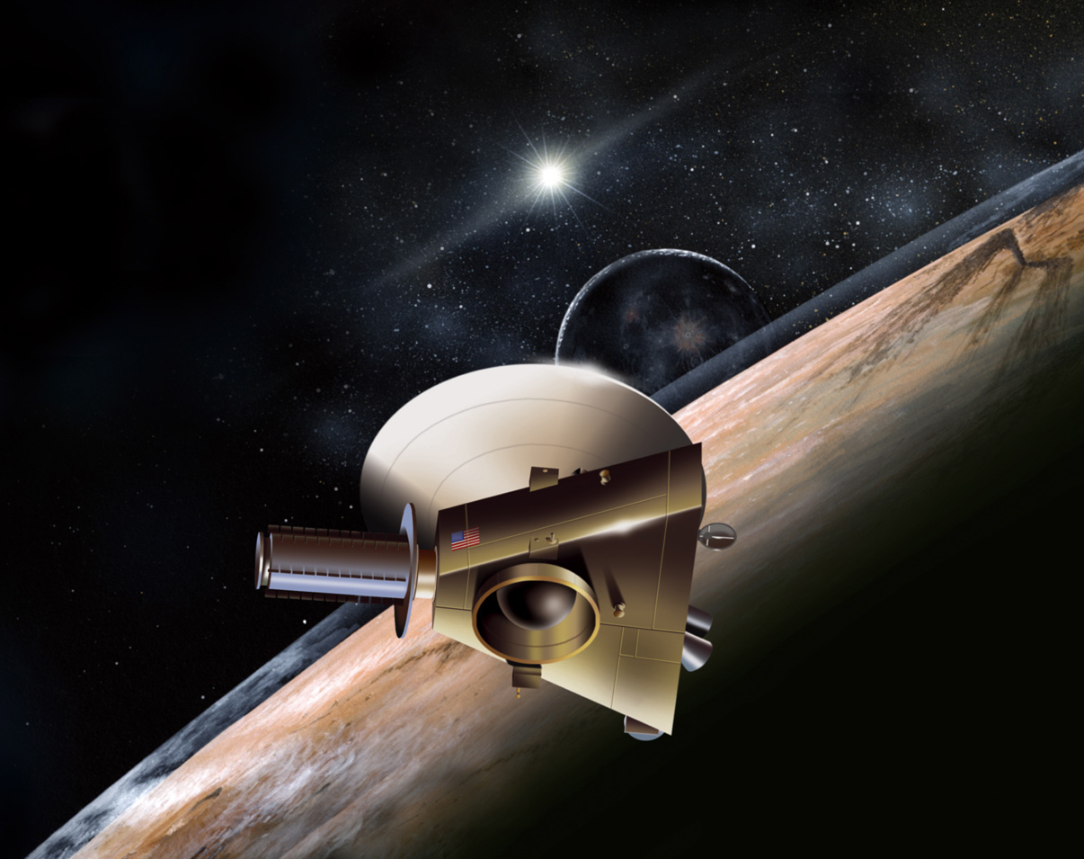

The abstract communications model
Information
Source
Encoder
Decoder
Destination
message
message

Slide 6
The power of the mind
“It deosn't mttaer in waht oredr the ltteers in a wrod are, the olny iprmoetnt tihng is taht the frist and lsat ltteer be at the rghit pclae.
The rset can be a toatl mses and you can sitll raed it wouthit porbelm.”

Slide 7
Entropy in English language
Average length: 4.76
Entropy per letter: 2.14

Slide 8
The power of the mind
“-t d--sn’t m-tt-r -n w--t -rd-r th- l-tt-rs -n a w-rd -r-, th- -nl- -mp-rt-nt th-ng -s th-t th- f-rst -nd l-st l-tt-r b- -t th- r-ght pl-c-.
Tie rost cun pe o tetul moss ald yae cen stoll roed at wotheit prablim.”

Slide 9
The power of the mind
Erasure channel
“-t d--sn’t m-tt-r -n w--t -rd-r th- l-tt-rs -n a w-rd -r-, th- -nl- -mp-rt-nt th-ng -s th-t th- f-rst -nd l-st l-tt-r b- -t th- r-ght pl-c-.
Symmetric channel
Tie rost cun pe o tetul moss ald yae cen stoll roed at wotheit prablim.”

Slide 10
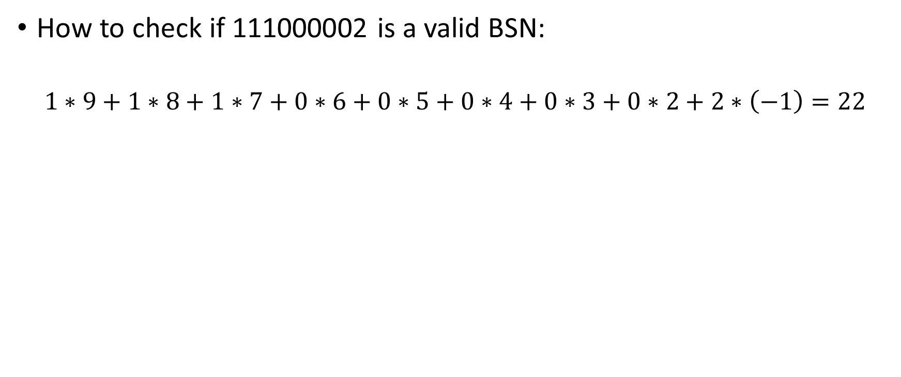
Elfproef
How to check if 111000002 is a valid BSN:
$$1∗9+1∗8+1∗7+0∗6+0∗5+0∗4+0∗3+0∗2+2∗\left(−1\right)=22$$

Slide 11
Codes for weather transmission
Noiseless channel
  Rain: ‘0’
  Sun: ‘1’

Slide 12
Codes for weather transmission
Noiseless channel
  Rain: ‘0’
  Sun: ‘1’
Exercise. Design a code that allows to detect one error.

Slide 13
Codes for weather transmission
Noiseless channel
  Rain: ‘0’
  Sun: ‘1’
Exercise. Design a code that allows to detect one error.
Exercise. Design a code that allows to detect one error.

Slide 14
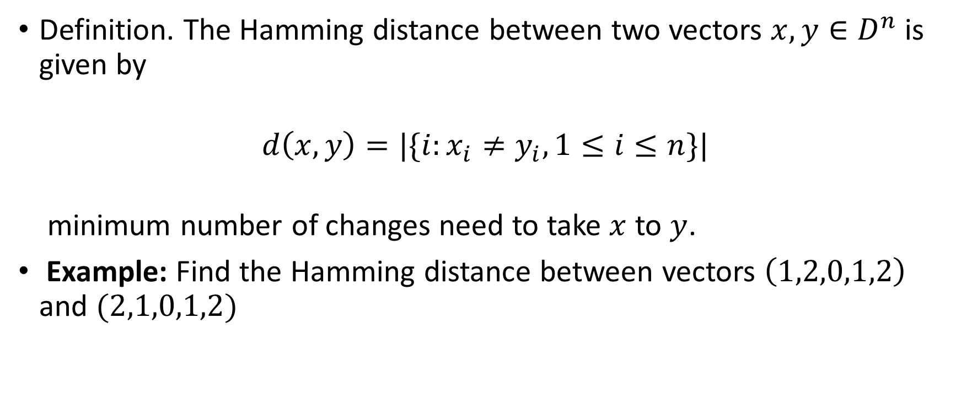
Hamming distance
Definition. The Hamming distance between two vectors $x,y∈D^{n}$ is given by
$$d\left(x,y\right)=|\{i:x_{i}≠y_{i},1≤i≤n\}|$$
minimum number of changes need to take $x$ to $y$.
Example: Find the Hamming distance between vectors $\left(1,2,0,1,2\right)$ and $(2,1,0,1,2)$

Slide 15
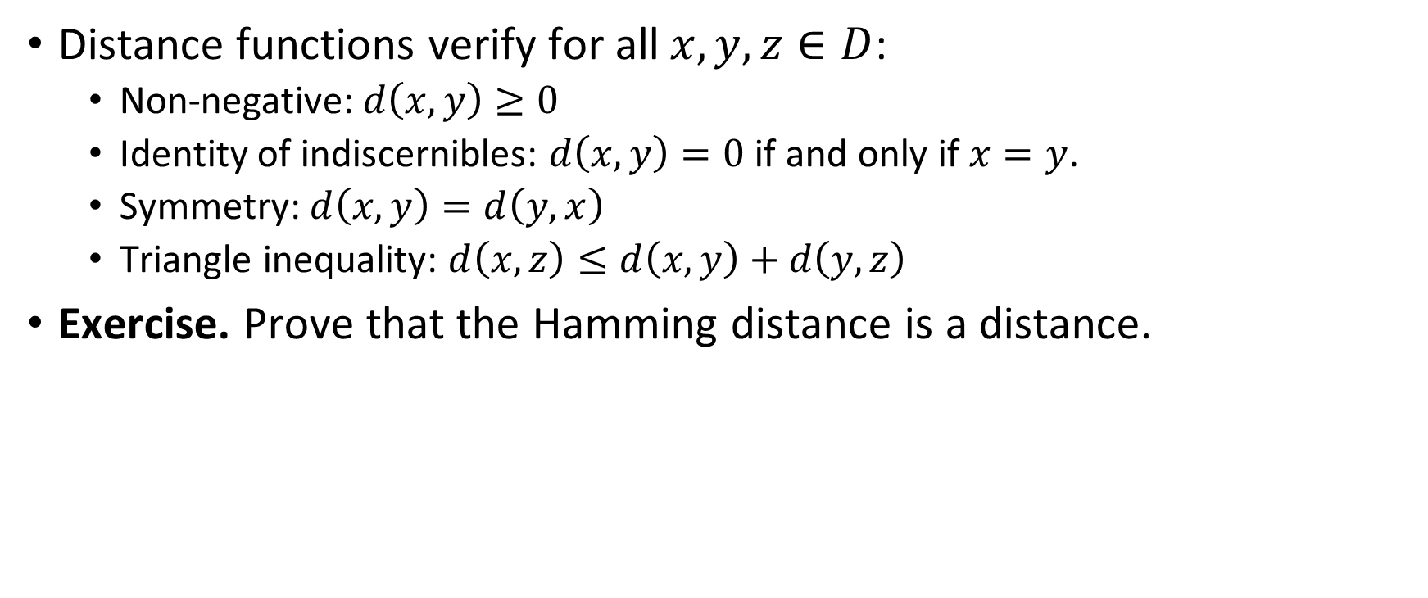
Properties of the Hamming distance
Distance functions verify for all $x,y,z∈D$:
  Non-negative: $d\left(x,y\right)≥0$
  Identity of indiscernibles: $d\left(x,y\right)=0$ if and only if $x=y$.
  Symmetry: $d\left(x,y\right)=d\left(y,x\right)$
  Triangle inequality: $d\left(x,z\right)≤d\left(x,y\right)+d\left(y,z\right)$
Exercise. Prove that the Hamming distance is a distance.
Notes:
D(x,z) is the minimum number of changes for taking x to z. We can understand the right hand side as a a concrete recipe for taking x to z: we can read it as first tod d(x,y) changes and take x to y, then do additionally d(y,z) changes and take y to z. Since this is some number that allows us to take x to z it can never be smaller than the minimum number.

Slide 16
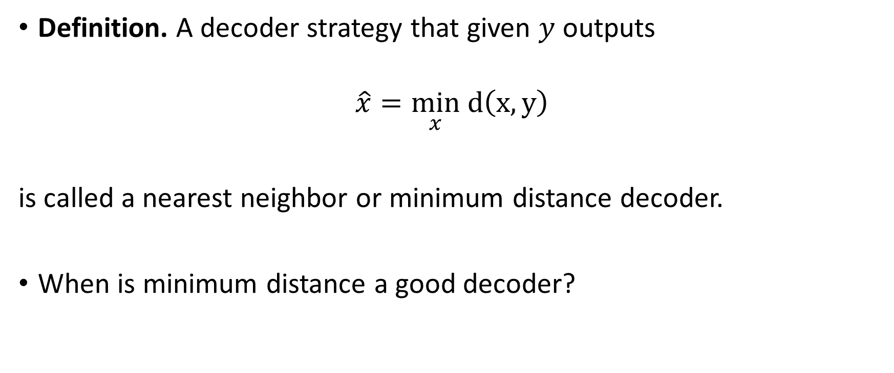
Nearest neighbor decoding
Definition. A decoder strategy that given $y$ outputs
$$\hat{x}=\min_{x} d\left(x,y\right)$$
is called a nearest neighbor or minimum distance decoder.
When is minimum distance a good decoder?

Slide 17
The binary symmetric channel

Slide 18
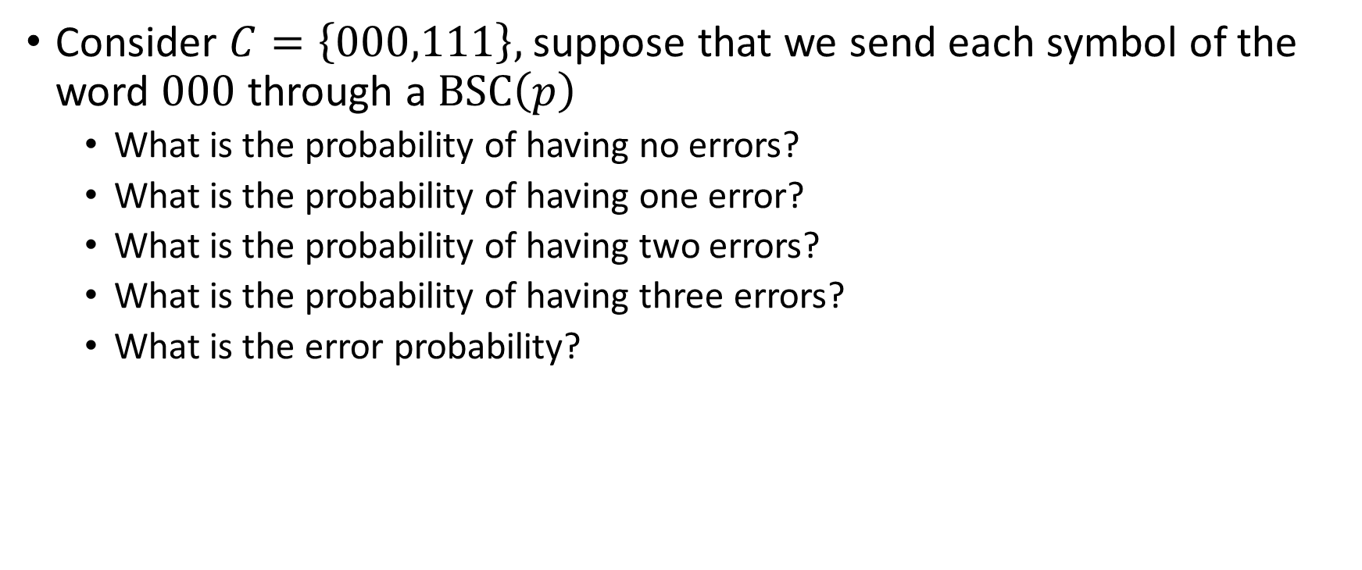
Probability of wrong decoding
Consider $C=\left\{000,111\right\},$ suppose that we send each symbol of the word $000$ through a $\text{BSC}\left(p\right)$
  What is the probability of having no errors?
  What is the probability of having one error?
  What is the probability of having two errors?
  What is the probability of having three errors?
  What is the error probability?

Slide 19
Combinatorics of errors
In how many different ways can one error occurs?
In how many different ways can two errors occurs?
In how many different ways can three errors occurs?
In how many different ways can zero error occurs?
Notes:
Error pattern!!!

Slide 20
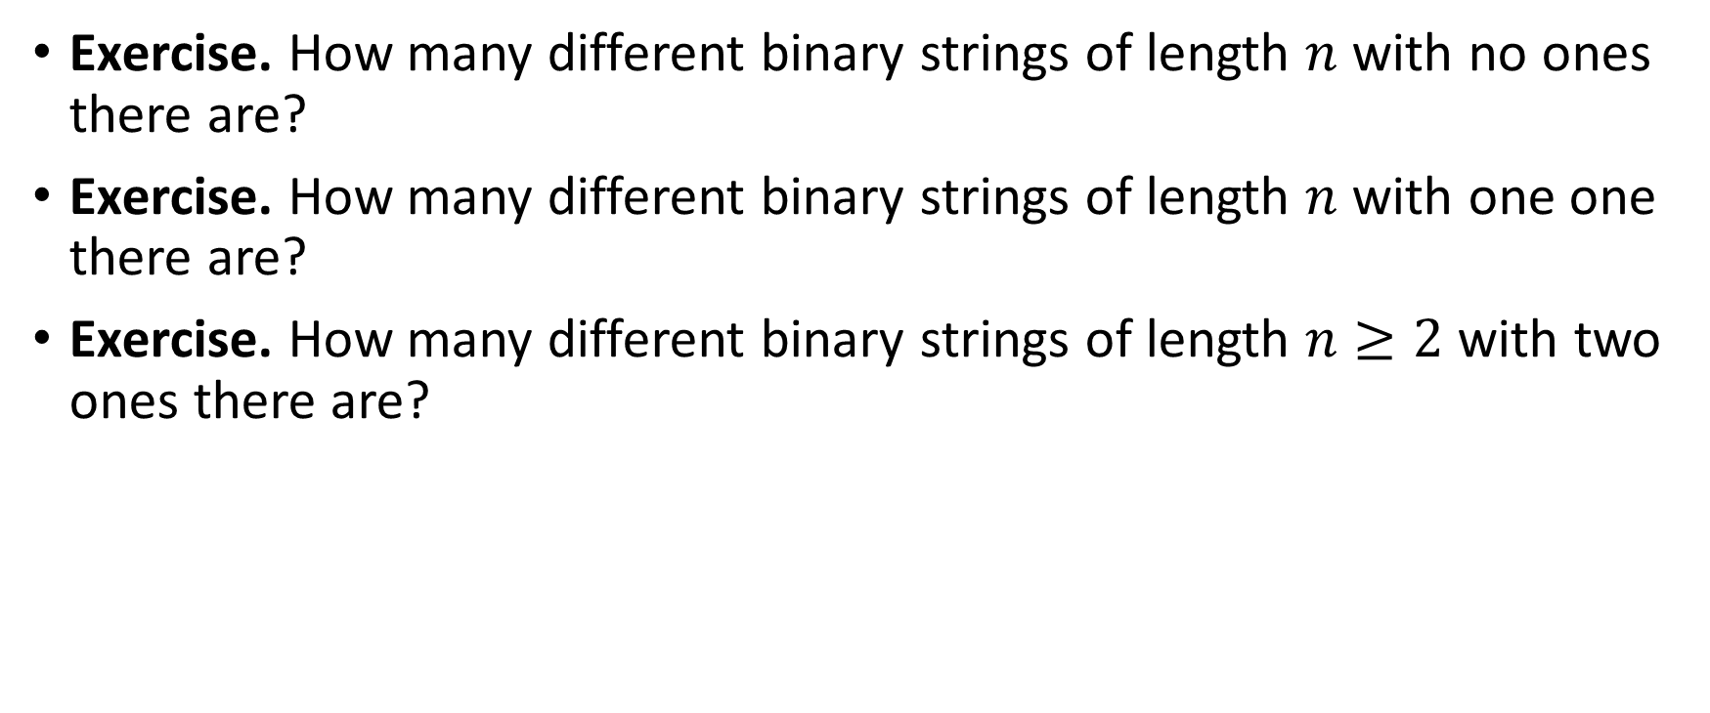
Combinatorial coefficients
Exercise. How many different binary strings of length $n$ with no ones there are?
Exercise. How many different binary strings of length $n$ with one one there are?
Exercise. How many different binary strings of length $n≥2$ with two ones there are?

Slide 21
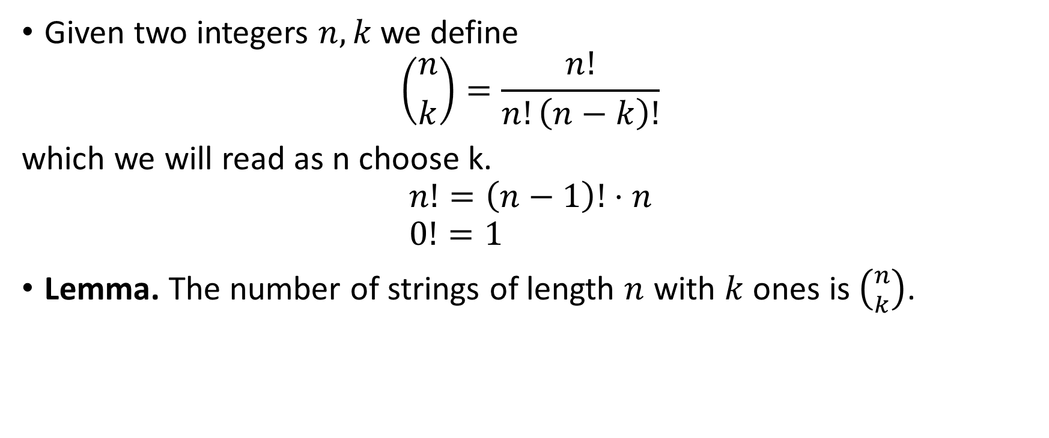
Combinatorial coefficients
Given two integers $n,k$ we define
$$\left({n \atop k}\right)=\frac{n!}{n!\left(n−k\right)!}$$
which we will read as n choose k.
$$n!=\left(n−1\right)!⋅n \\ 0!=1$$
Lemma. The number of strings of length $n$ with $k$ ones is $\left({n \atop k}\right)$.

Slide 23
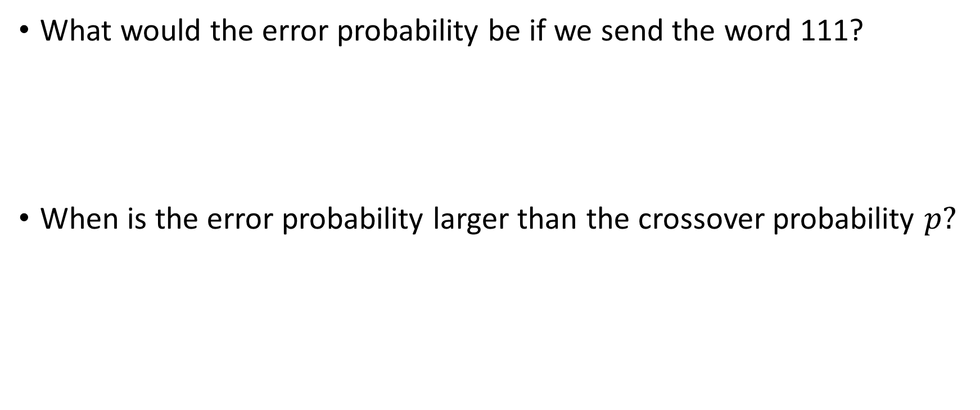
Remarks on the BSC
What would the error probability be if we send the word 111?
When is the error probability larger than the crossover probability $p?$

Slide 24
Decoding error vs crossover probability

Slide 25
The binary erasure channel

Slide 26
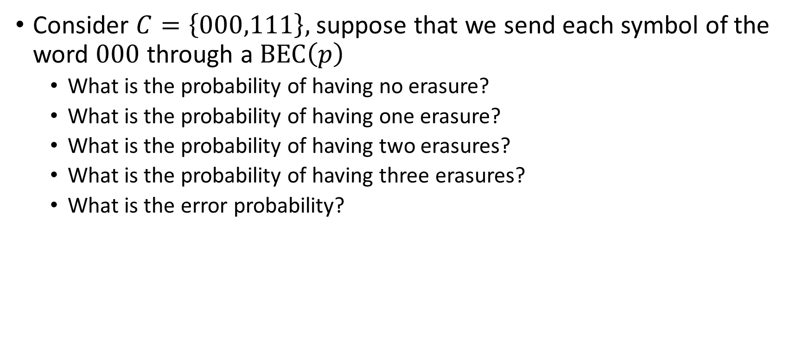
Probability of wrong decoding
Consider $C=\left\{000,111\right\},$ suppose that we send each symbol of the word $000$ through a $\text{BEC}\left(p\right)$
  What is the probability of having no erasure?
  What is the probability of having one erasure?
  What is the probability of having two erasures?
  What is the probability of having three erasures?
  What is the error probability?

Slide 27
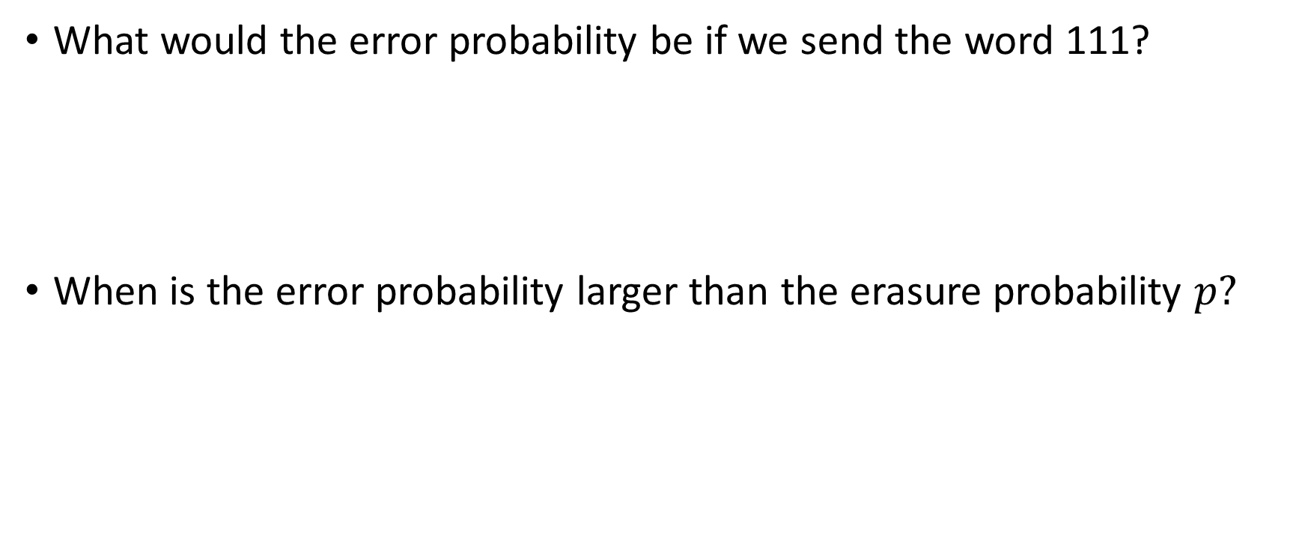
Remarks on the BEC
What would the error probability be if we send the word 111?
When is the error probability larger than the erasure probability $p?$

Slide 28
Decoding error vs erasure probability

Slide 29
Learning goals for week 3
Understand what is an error correcting code and what are its basic properties
Construct Hamming codes

Slide 30
TN3125
Information and Computation
Lecture 2
Codes

Slide 31
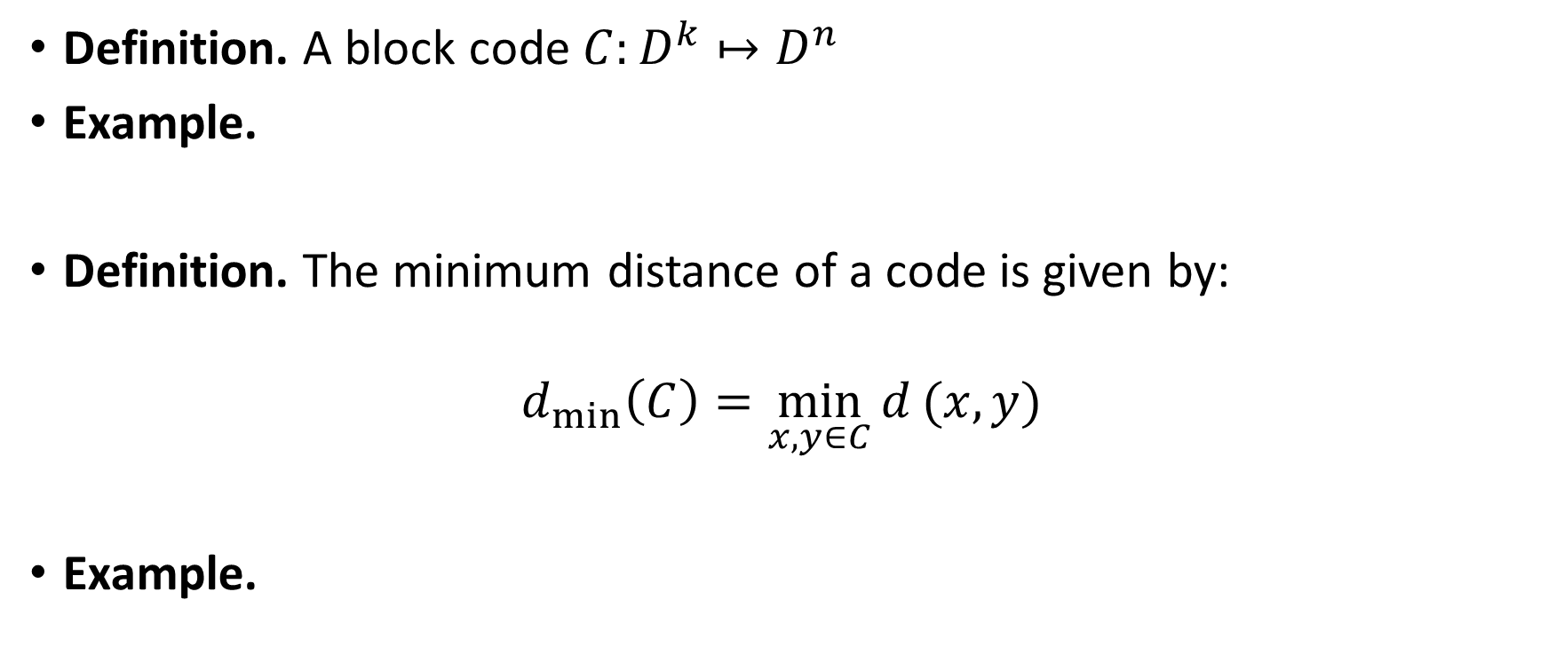
Block codes
Definition. A block code $C:D^{k}↦D^{n}$
Example.
Definition. The minimum distance of a code is given by:
$$d_{min⁡}\left(C\right)=\min_{x,y∈C}{d}(x,y)$$
Example.

Slide 32
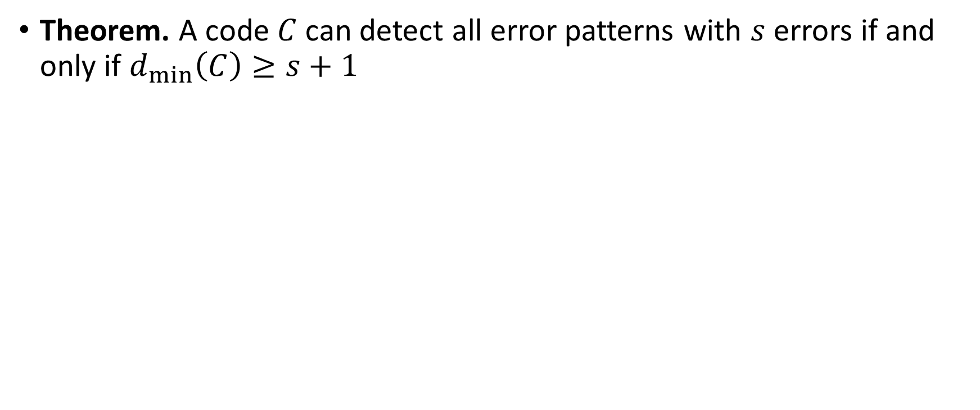
Detection capabilities of a code
Theorem. A code $C$ can detect all error patterns with $s$ errors if and only if $d_{min⁡}\left(C\right)≥s+1$

Slide 33
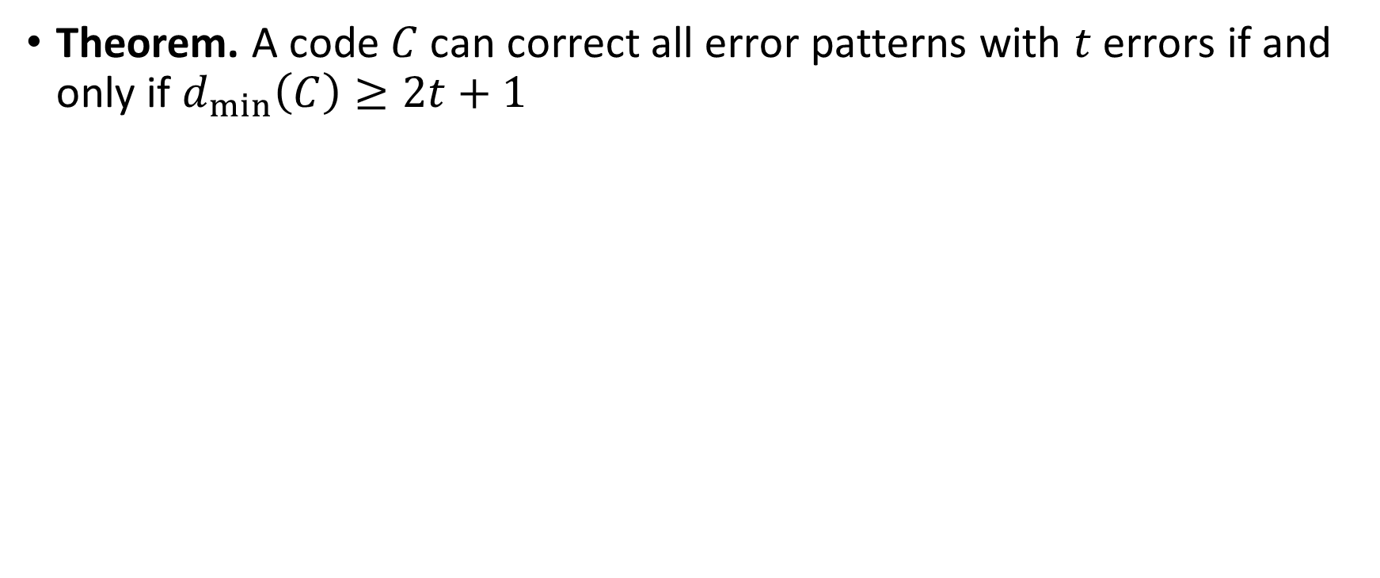
Correction capabilities of a code
Theorem. A code $C$ can correct all error patterns with $t$ errors if and only if $d_{min⁡}\left(C\right)≥2t+1$

Slide 34
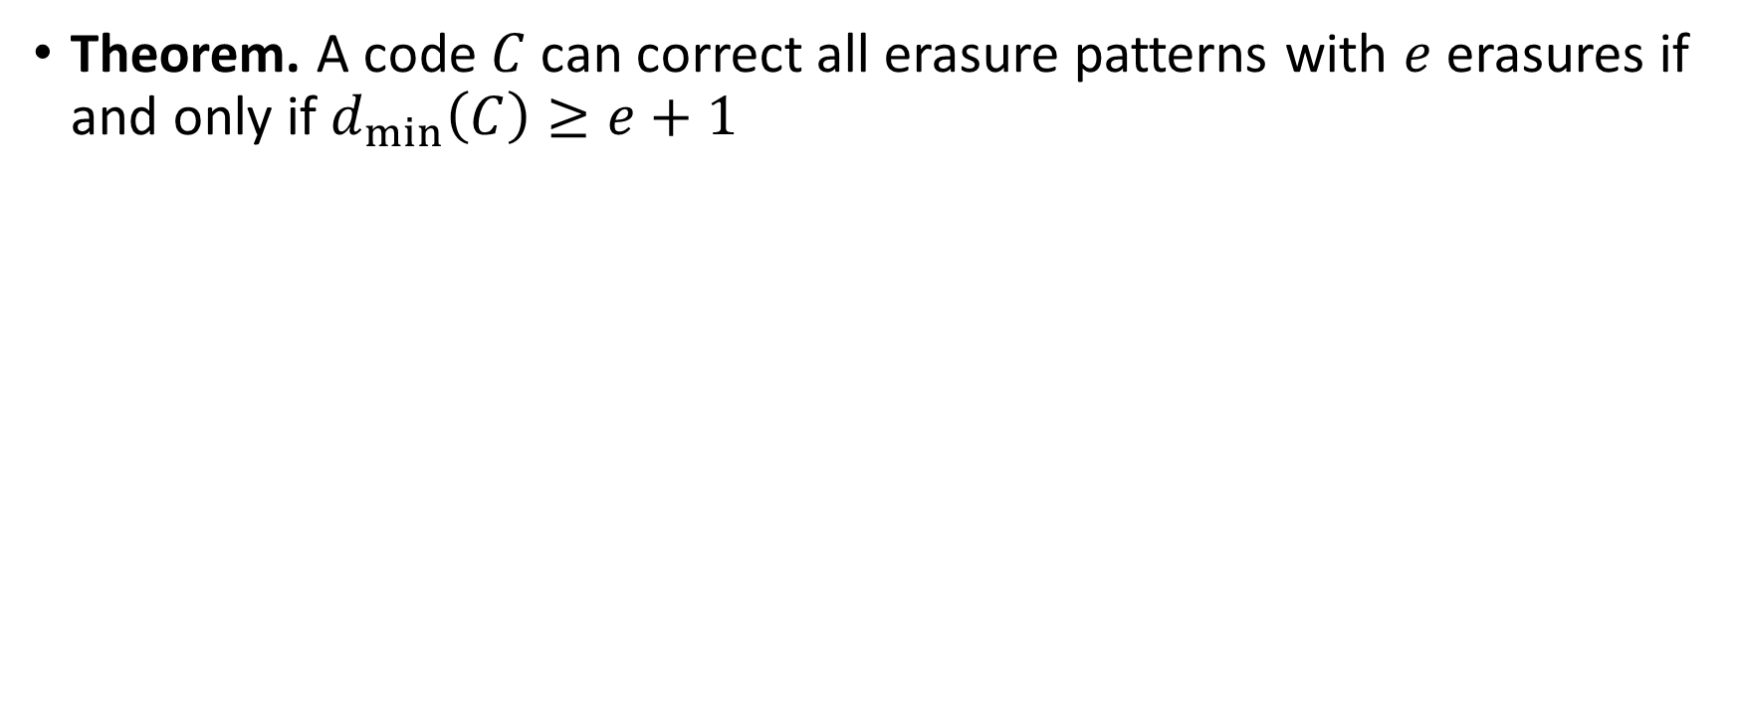
Correction capabilities of a code
Theorem. A code $C$ can correct all erasure patterns with $e$ erasures if and only if $d_{min⁡}\left(C\right)≥e+1$

Slide 35
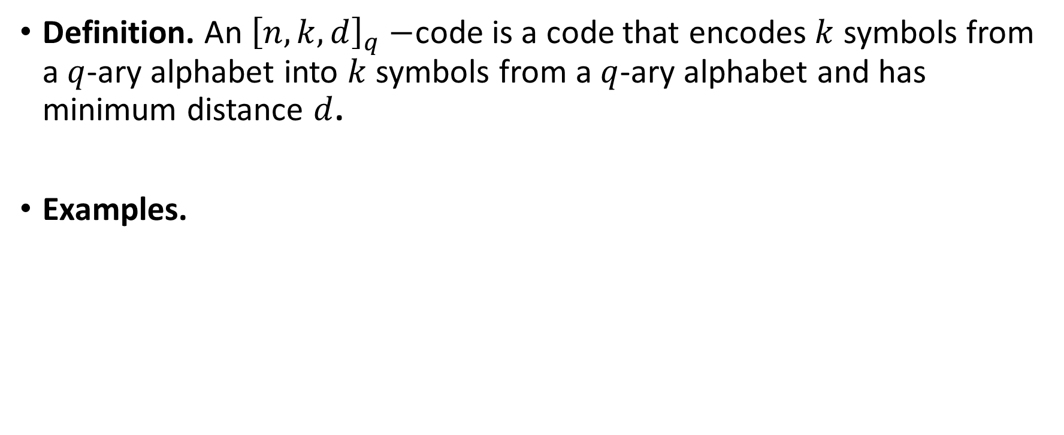

$${\left[n,k,d\right]}_{q}$$
Definition. An ${\left[n,k,d\right]}_{q}−$code is a code that encodes $k$ symbols from a $q$-ary alphabet into $k$ symbols from a $q$-ary alphabet and has minimum distance $d$.
Examples.

Slide 36
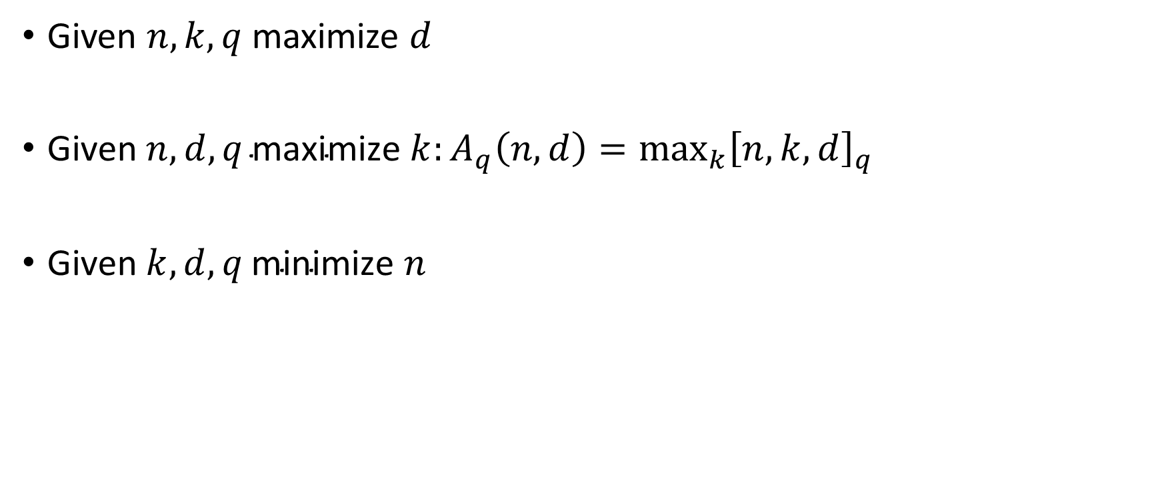
Coding problems
Given $n,k,q$ maximize $d$
$\text{Given} n,d, q \text{maximize} k:A_{q}\left(n,d\right)={\max_{k}\left[n,k,d\right]}_{q}$
$\text{Given} k,d,q \text{minimize} n$

Slide 37
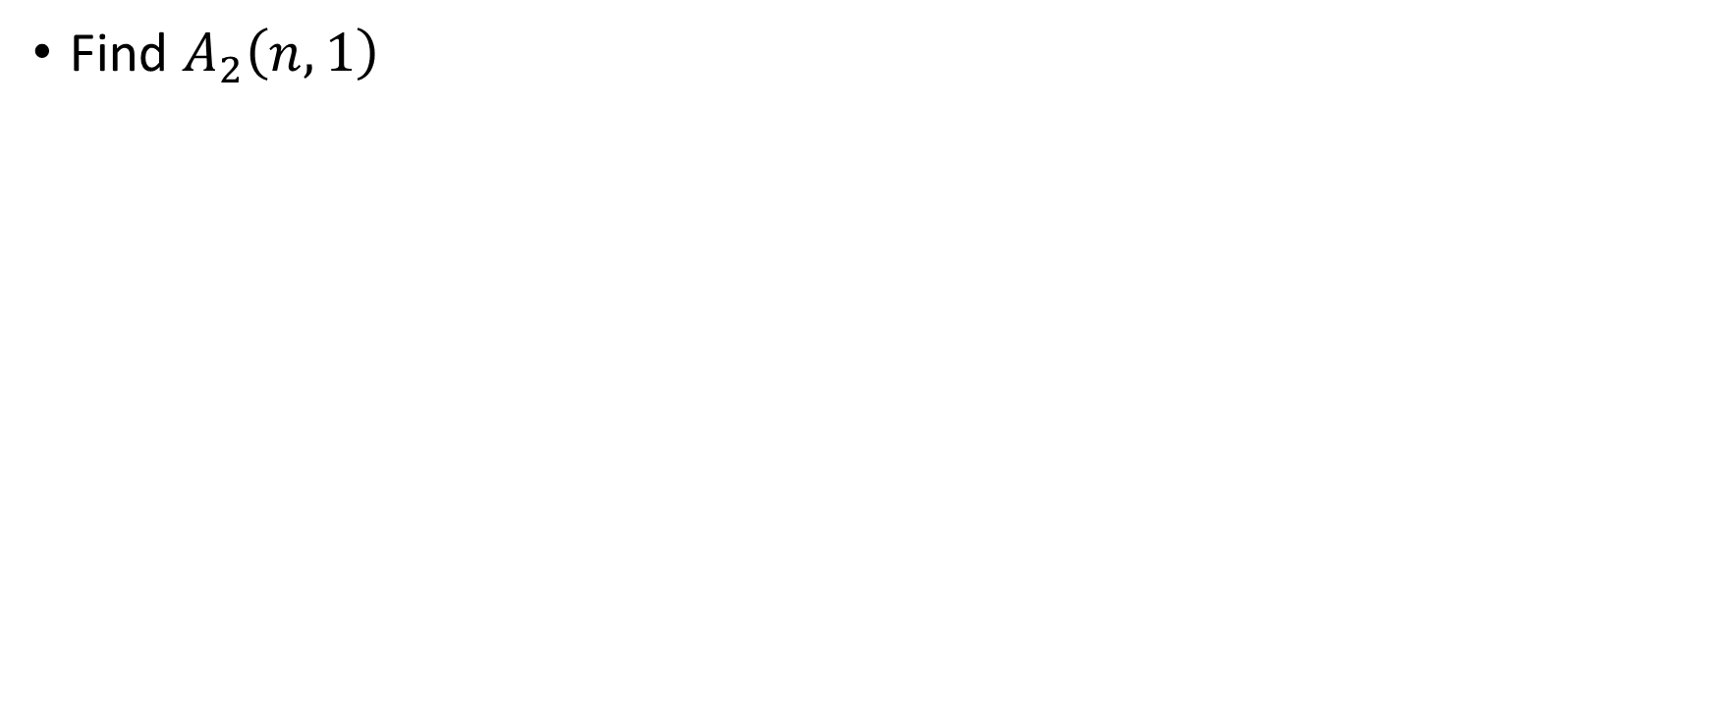
Exercise
Find $A_{2}\left(n,1\right)$

Slide 38
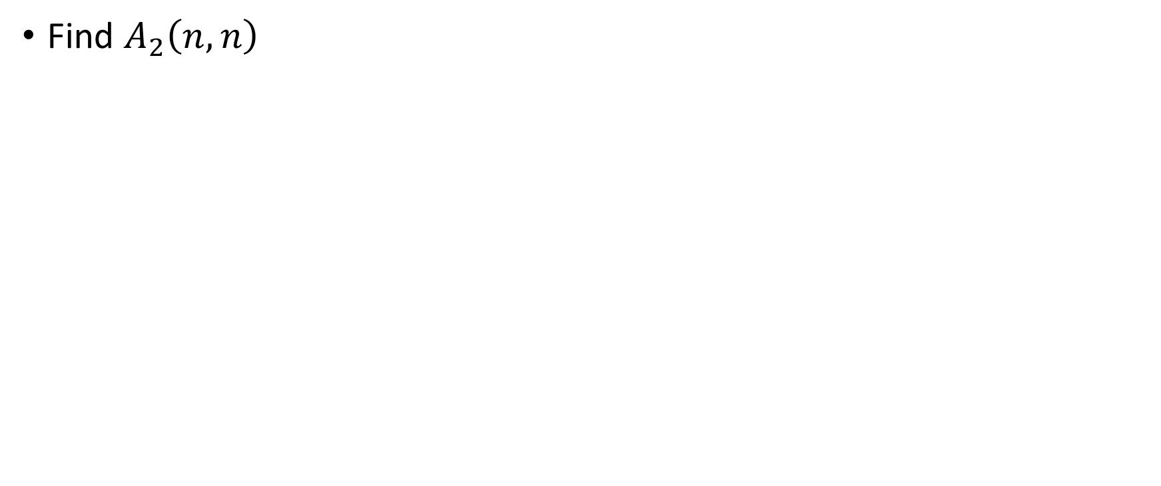
Exercise
Find $A_{2}\left(n,n\right)$

Slide 39
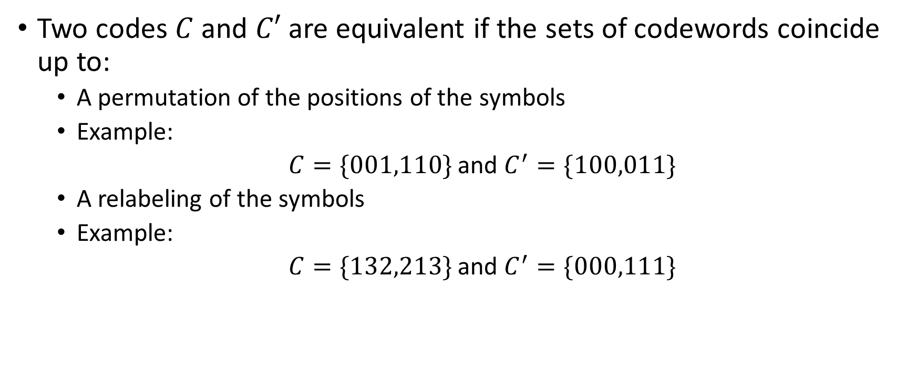
Equivalent codes
Two codes $C$ and $C′$ are equivalent if the sets of codewords coincide up to:
  A permutation of the positions of the symbols
  Example:
  $C=\{001,110\}$ and $C^{′}=\{100,011\}$
  A relabeling of the symbols
  Example:
  $C=\{132,213\}$ and $C^{′}=\{000,111\}$

Slide 40

Bounds on minimum distance, $B_{q}\left(n,k\right)$
n/k | 1 | 2 | 3 | 4 | 5 | 6 | 7 | 8 | 9 | 10 | 11 | 12 | 13 | 14 | 15 | 16 | 17 | 18 | 19 | 20 | 21 | 22 | 23 | 24 | 25 | 26 | 27 | 28 | 29 | 30 | 31 | 32
1 | 1
2 | 2 | 1
3 | 3 | 2 | 1
4 | 4 | 2 | 2 | 1
5 | 5 | 3 | 2 | 2 | 1
6 | 6 | 4 | 3 | 2 | 2 | 1
…
31 | 31 | 20 | 17 | 16 | 16 | 15 | 13 | 12 | 12 | 12 | 11 | 10 | 9 | 8 | 8 | 8 | 7 | 6 | 6 | 6 | 5 | 4 | 4 | 4 | 4 | 3 | 2 | 2 | 2 | 2 | 1
32 | 32 | 21 | 18 | 16 | 16 | 16 | 14 | 13 | 12 | 12 | 12 | 10 | 10 | 8-9 | 8 | 8 | 8 | 6-7 | 6 | 6 | 6 | 5 | 4 | 4 | 4 | 4 | 2 | 2 | 2 | 2 | 2 | 1
http://www.codetables.de/BKLC/Tables.php?q=2&n0=1&n1=32&k0=1&k1=20

Slide 41
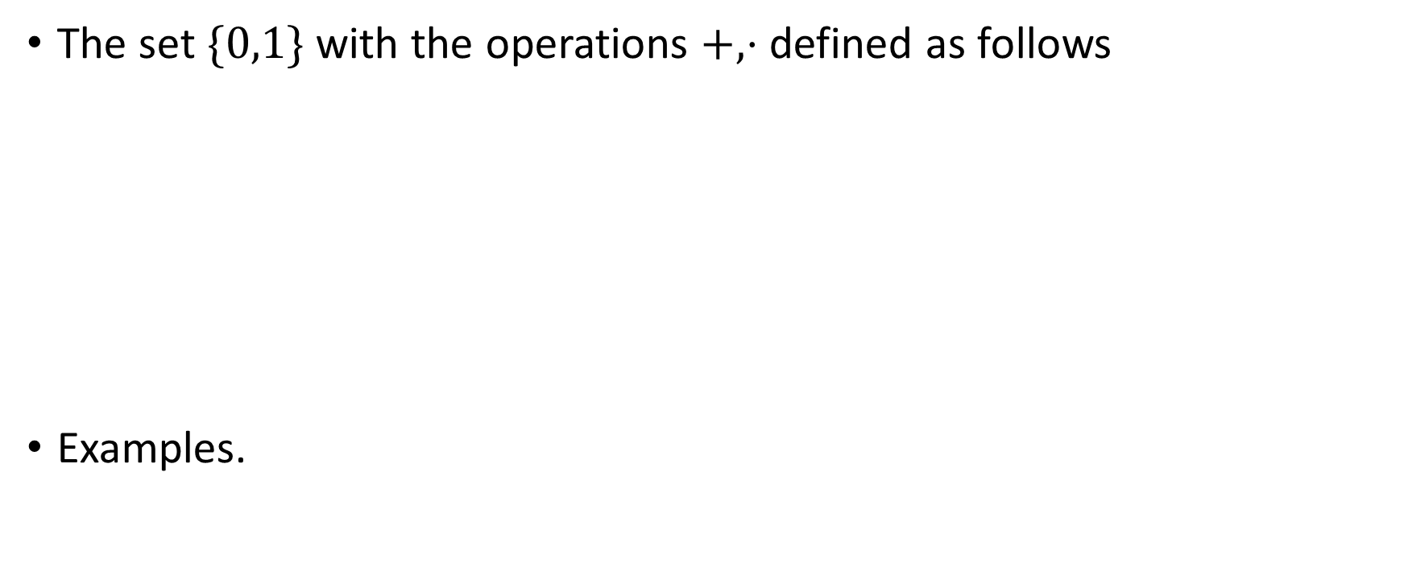

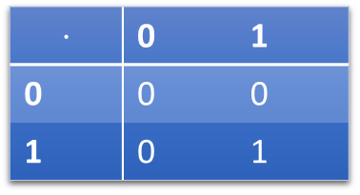
The finite field $F_{2}$
The set $\{0,1\}$ with the operations $+,⋅$ defined as follows
Examples.
+ | 0 | 1
0 | 0 | 1
1 | 1 | 0
$$⋅$$ | 0 | 1
0 | 0 | 0
1 | 0 | 1

Slide 42
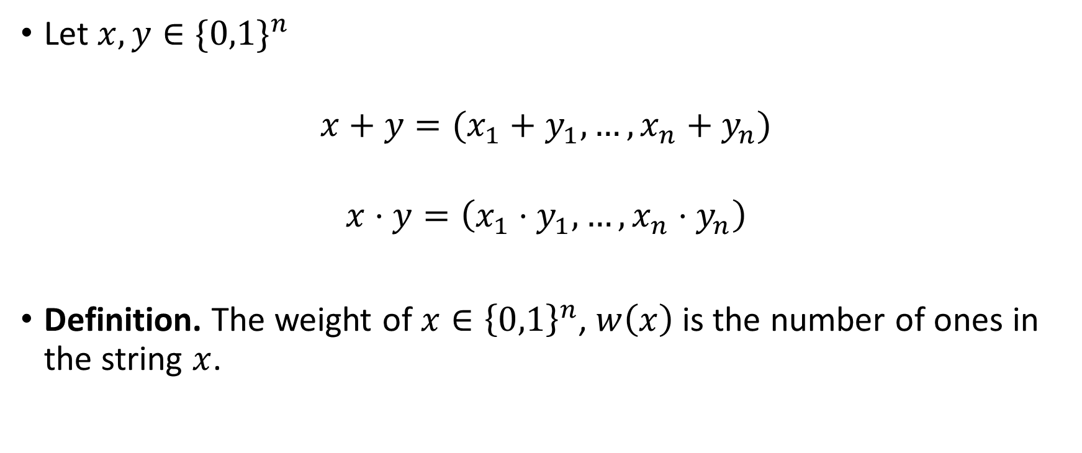

The finite field $F_{2^{n}}$
Let $x,y∈\{0,1\}^{n}$
$$x+y=(x_{1}+y_{1},…,x_{n}+y_{n})$$
$$x⋅y=\left(x_{1}⋅y_{1},…,x_{n}⋅y_{n}\right)$$
Definition. The weight of $x∈{\left\{0,1\right\}}^{n}$, $w\left(x\right)$ is the number of ones in the string $x$.

Slide 43
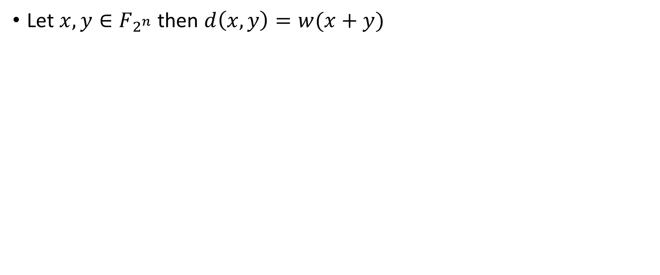
Exercise
Let $x,y∈F_{2^{n}}$ then $d\left(x,y\right)=w(x+y)$

Slide 44
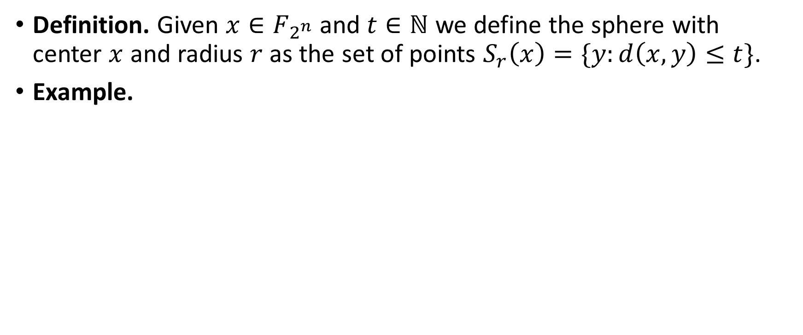
Spheres
Definition. Given $x∈F_{2^{n}}$and $t∈ℕ$ we define the sphere with center $x$ and radius $r$ as the set of points $S_{r}\left(x\right)=\{y:d\left(x,y\right)≤t\}$.
Example.

Slide 45
Error correction graphically

Slide 46
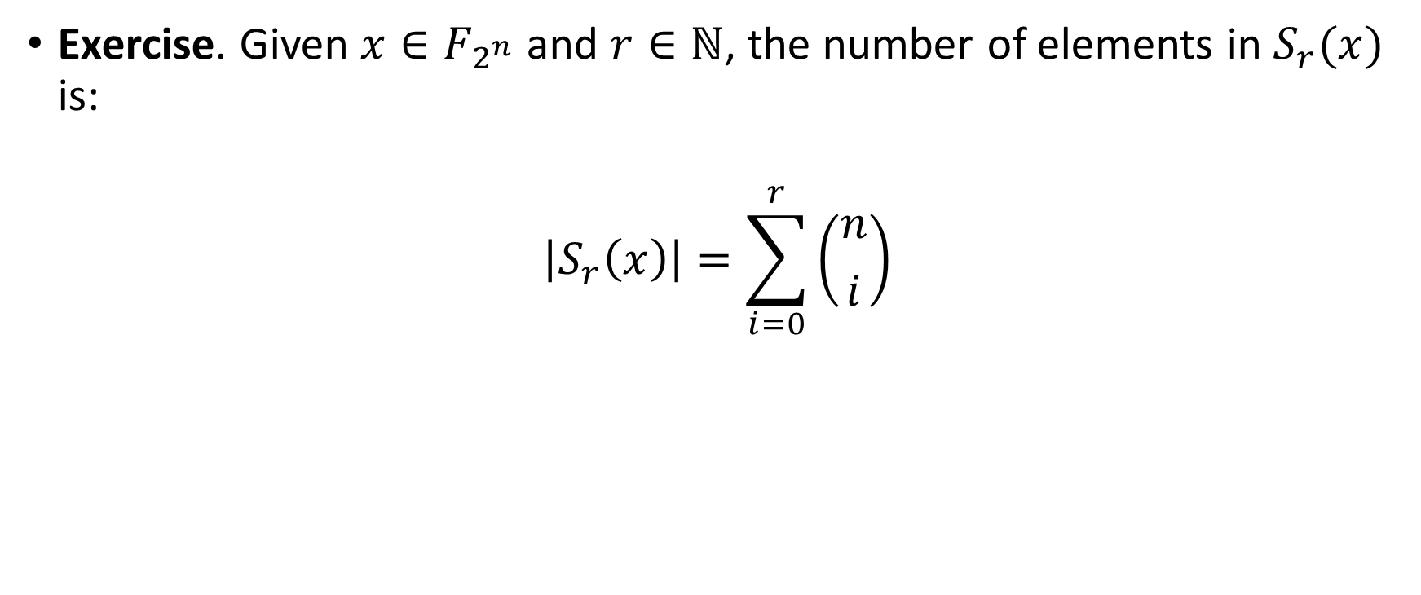
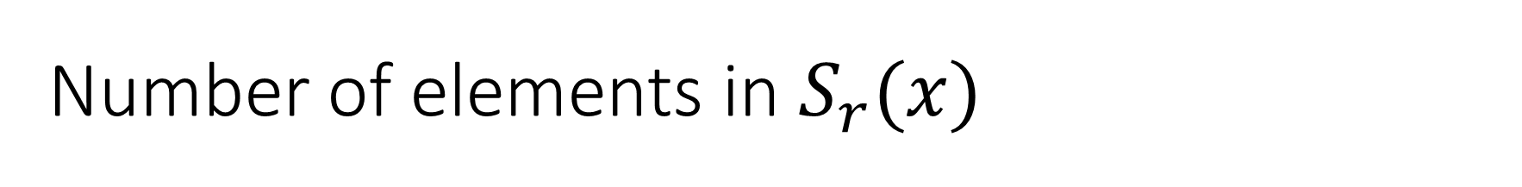
Number of elements in $S_{r}(x)$
Exercise. Given $x∈F_{2^{n}}$and $r∈ℕ$, the number of elements in $S_{r}(x)$ is:
$$\left|S_{r}\left(x\right)\right|=\sum_{i=0}^{r}{\left({n \atop i}\right)}$$

Slide 47
Hamming bound

Slide 48
Perfect codes

Slide 49
You will do great in the exam if

Slide 50



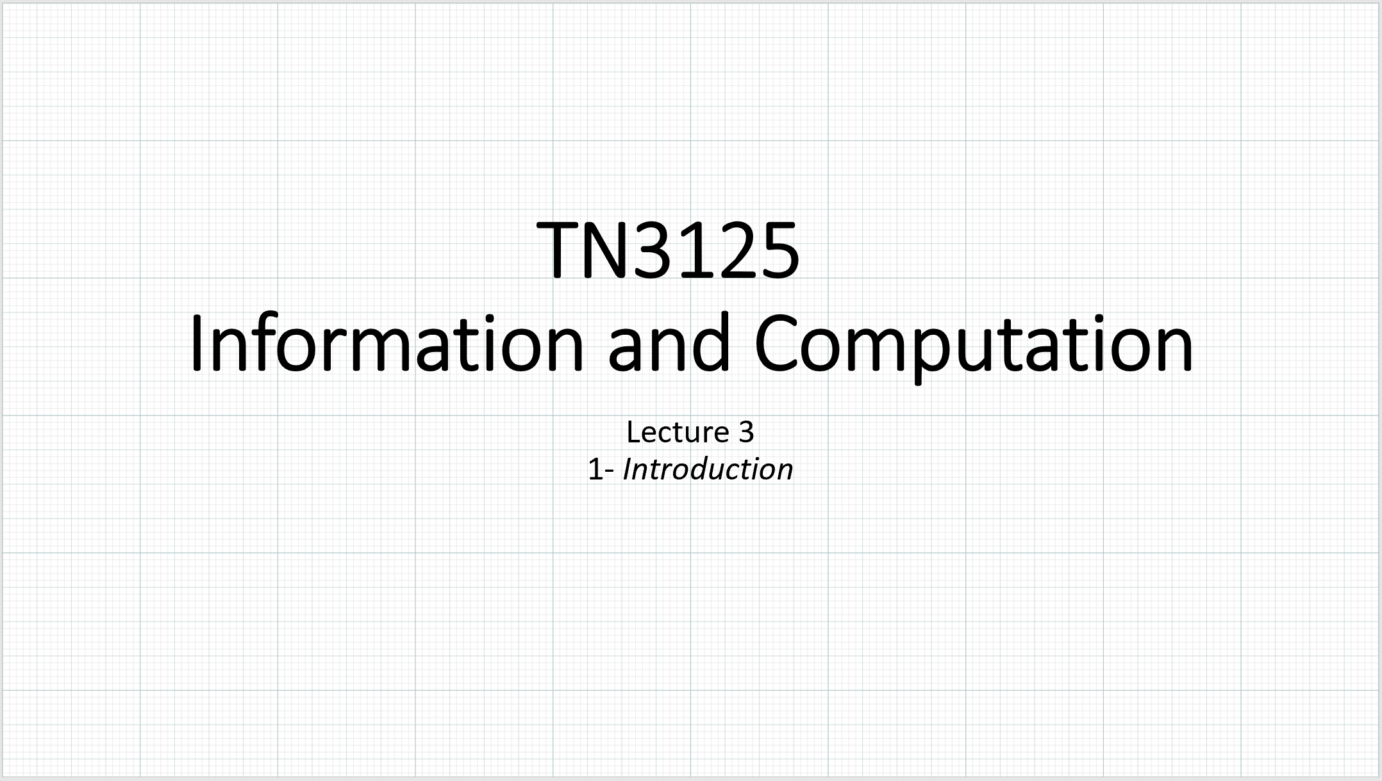
Resources
Lecture notes
Slides
Cover and Thomas chapter X
MacKay chapters X

